Slide 1
Mental Health Awareness Week
18th-24th May

Slide 2
Why MHAW?
We think it could be the most important week we’ve hosted, not least because our own research shows that protecting our mental health is going to be central to us coping with and recovering from the coronavirus pandemic - with the psychological and social impacts likely to outlast the physical symptoms of the virus.

Slide 3
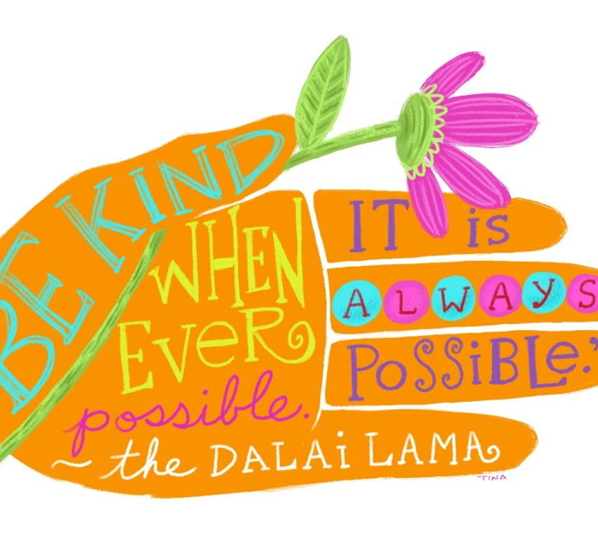
Why Kindness?
We have chosen kindness because of its singular ability to unlock our shared humanity. Kindness strengthens relationships, develops community and deepens solidarity. It is a cornerstone of our individual and collective mental health. Wisdom from every culture across history recognises that kindness is something that all human beings need to experience and practise to be fully alive.
But we also want to shine a light on the ways that kindness is already flowering at this time. We have seen it in the dancing eyes of 100-year-old Captain Tom Moore as he walked his garden to raise money for the NHS and in the mutual aid groups responding to local needs. We want that kindness to spread further in every community in the UK.
Finally, we want to use the week to explore the sort of society we would like to emerge from the coronavirus pandemic.

Slide 4
Kindness to others
‘One thing that we have seen all over the world is that kindness is prevailing in uncertain times. We have learnt that amid the fear, there is also community, support and hope,’
Kindness could transform our schools, places of work, communities and families. Let's shape a society that tips the balance in favour of good mental health, for all of us, but especially for those who are most vulnerable.

Slide 5
Bootham Kindness Record
Email acts of kindness that you have seen or taken part in to beth.steer@boothamschool.com

Slide 6
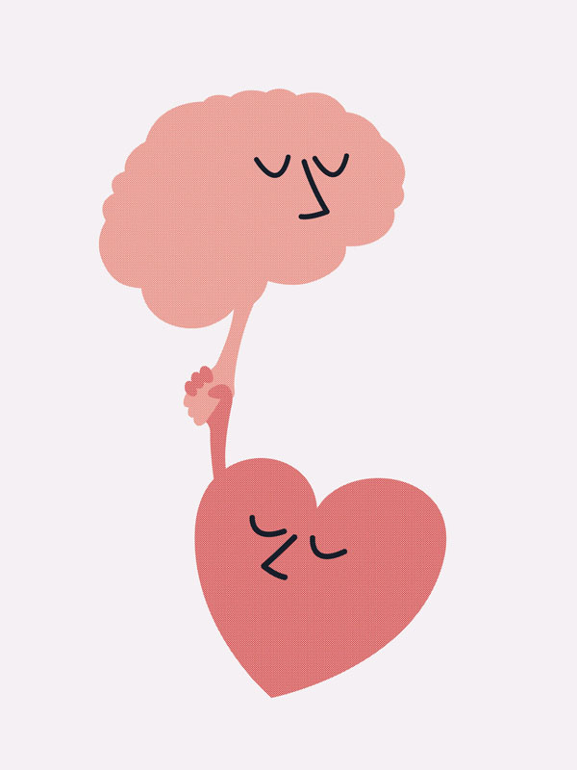
Kindness to ourselves
Speak with kind honesty – as to a close friend
Treat yourself like a two year old
Accept “good enough”

Slide 7
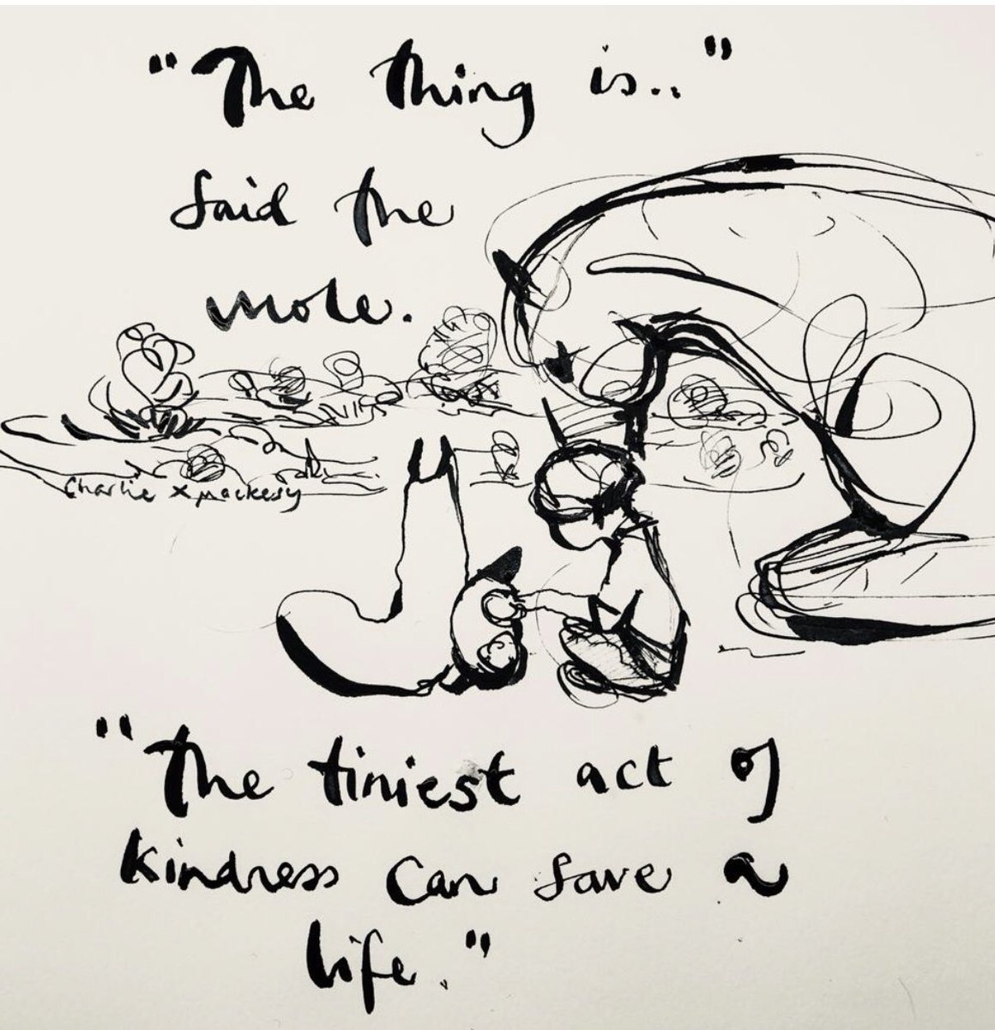
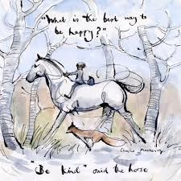
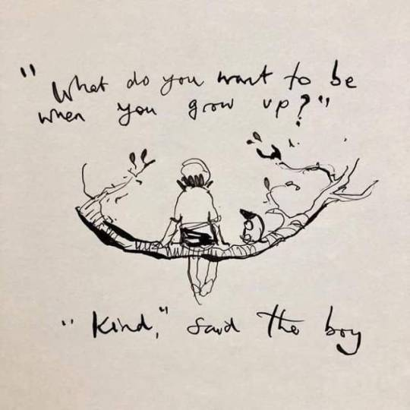

Slide 8
Support
In School
Out of School
Health Centre
Luke Highstead; School Counsellor
Tutor
Head of Year
Boarding Team
Leadership Meeting
Your GP
Mental Health Foundation
Blurt
Mind
Samaritans: 116 123
YoungMinds

