Slide 1
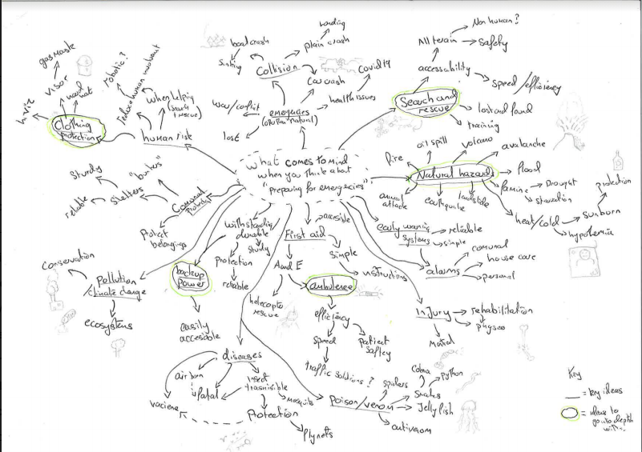
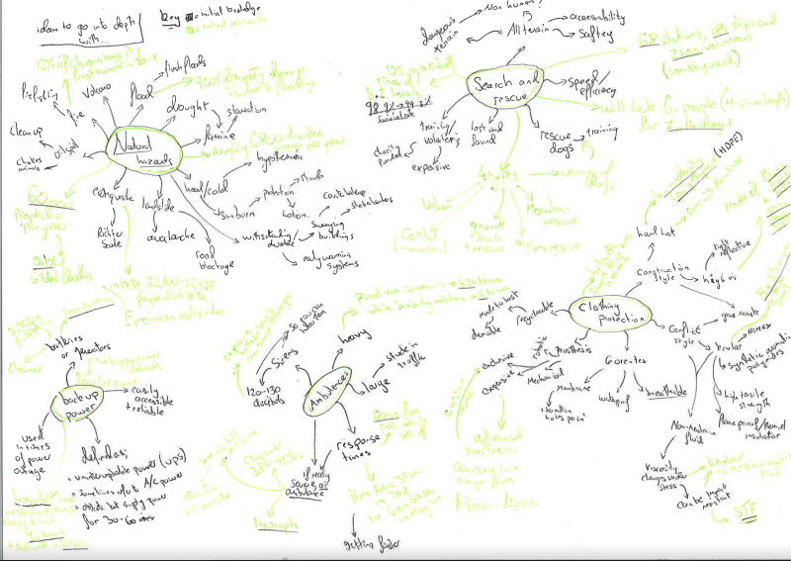
Mind map + initial research on contextual challenge

Slide 2
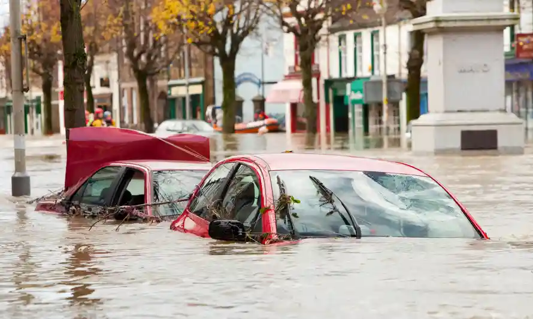
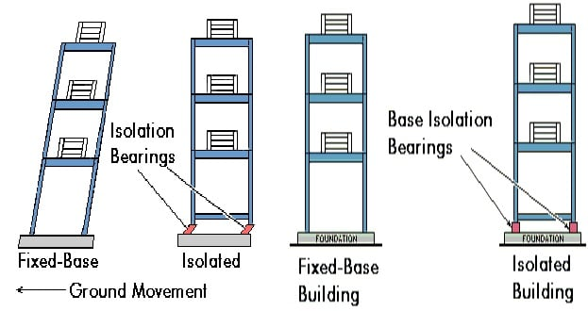
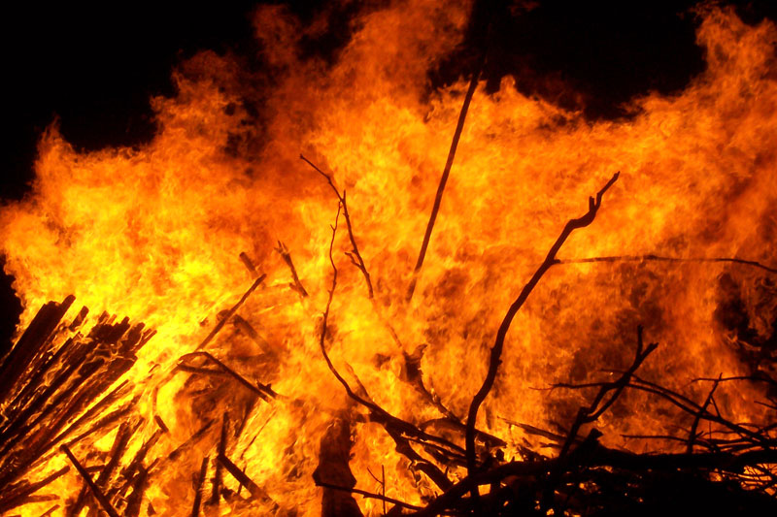
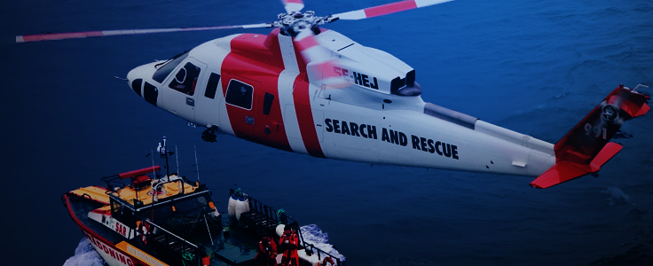
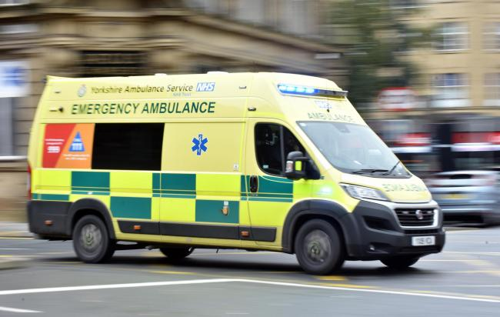
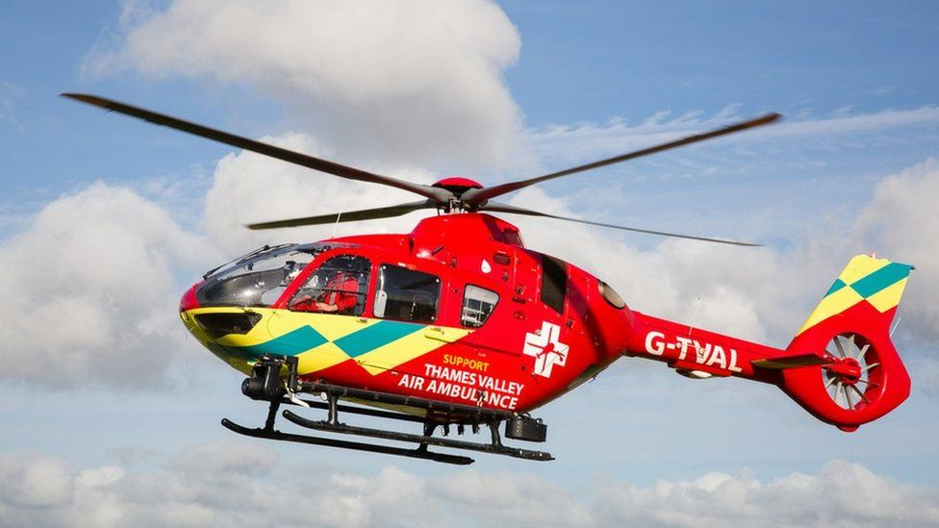
Identifying a problem
Contextual challenge
Preparing for emergencies
Problems/ areas of study/ investigation with photos and research
Maintaining property from natural disasters, flooding causes 90% of all property damage in the uk. In 2019 flooding caused approximately $3.75 billion worth of property and crop damage in the US alone.
Earthquake protection, can include structural support in buildings or protection. 32,700-32,968 people died in the Erzincan earthquake of 1939.
Fire fighting – can be human protection or forest fire, can be multipurpose for both issues. 12% of the Chiquitano dry forest burned in 2019. 70,000 wildfires a year since 1983. how can I tackle the spread and starting of these fires?
How to protect search and rescue members who are put in danger trying to rescue others, https://www.bcsara.com/service/wall-of-honour/ → is a list of those who died in action helping others. Stretchers need 4 people to carry one person, so needs a team of people to save 1 person… a team of people put in danger to help those in need of rescue. How do I bring down the number of those at risk? (could be non human?)
Ambulance response times are averaging 6min 54 secs, (it was 7min 37sec) however an ambulance can weigh 4.25 – 5 tonnes, they have a 6.7 L V8 turbo diesel engine with 270 hp, this is bad for the environment as diesel is a fossil fuel. How can I decrease ambulance response times and decrease ambulance pollution.
Air ambulances can go 140mph and cover an area of 3850 sq miles, they take 4mins until airborne then 15 min till arrival, how do I decrease the lift off speed of a helicopter or ensure a safer landing nearer the patient?
Initial research into areas of investigation
According to… https://insights.samsung.com/2021/02/24/four-critical-issues-facing-fire-services-today-2/ , 4 major problems for firefighters include funding, communications, coordination of resources and safety. 48 firefighters died in 2019, mainly due to heart attack from over stress and overexertion. Thousands more are injured at incidents. Fire fighters pose a 250% more chance of cancer due to the constant exposure of carcinogens, 63% of firefighters will contract cancer during their lifetime.
The most prevalent of all injury types include strains, muscular pains, and sprains due to over exertion. Other common injuries include falls, jumps, and slips. The overall number of incidents are declining but there has been minimal improvement.
Rookie firefighter mistakes are 1. refusing to wear a seatbelt in an emergency, to save time. 2. don’t wear structural PPE in situations where it can cause heat stress and lack of mobility (wildland fires are mobile). 3. don’t rely on luck.
The different types of PPE include face shields, gloves, goggles and glasses, gowns, head covers, masks, respirators, and shoe covers. Face shields, gloves, goggles and glasses, gowns, head covers, and shoe covers protect against the transmission of germs through contact and droplet routes.
Firefighting clothes are made of Nomex and Kevlar fibres, glass, carbon , and vacuum-deposited aluminized materials that reflect the high radiant loads produced by the fire. The “turnouts” gear is designed to be ambient to heat and from hot gasses/smoke and be mobile but it isn’t fireproof.
Client --> Steven Brewer
Steve is my dad but also a text mining business owner, he is self employed with the company textminingsolutions which helps find pieces of information wanted by clients from huge pieces of data. He’s got qualifications in BSC chemistry and MSC forensic science at university and has worked for FERA (a biology lab). He has been a helpful outside perspective to dt projects in the past

