Slide 1
Choosing GCSE options

Slide 2
Core examined subjects
English (Language and Literature as a First Language OR English as a Second Language)
Maths (some students will be invited to take the Further Maths exam as well)
At least one Science (Biology, Chemistry or Physics)

Slide 3
Students should also choose one subject from each of the following curriculum areas:
Modern Foreign Languages: French, Spanish, German
Humanities: History, Geography, Classical Civilisation, Latin, Religious Studies
Creative and practical subjects: Art and Design, Drama, Music, Design and Technology, Physical Education, Computer Science

Slide 4
This leaves students with two more options. They can choose any subject that they have not already chosen from the Sciences, the Humanities, Modern Foreign Languages, and the Creative and Practical subjects. Some students will be invited to join Curriculum Support as one of these options.

Slide 5
Some students will be invited to join a Triple Science group. For this group, all three sciences will be taught in the time that we would normally allocate to two subjects. Emails of invitation will be sent out by the end of this week.

Slide 6
Students who are not invited to join the Triple Science group can still choose to study all three sciences.

Slide 7
Compulsory non-examined subjects
PSHE
PE

Slide 8
Two flexible periods
The changes to Saturday school timetabling mean that we will have two flexible periods each fortnight.
Supported study
Bootham project
Triple Science

Slide 9
Student example A – First Language English, no Curriculum Support
Compulsory subjects | Subject area choices | Other options | Non examined compulsory subjects
English Language | Spanish | Biology | PSHE
English Literature | Classics | Music | PE
Maths | Drama
Chemistry

Slide 10
Student example B – First Language English, with Curriculum Support
Compulsory subjects | Subject area choices | Other options | Non examined compulsory subjects
English Language | Spanish | Curriculum Support | PSHE
English Literature | Classics | Music | PE
Maths | Drama
Chemistry

Slide 11
Student example C – English as an Additional Language, no Curriculum Support, mainstream English not appropriate
Compulsory subjects | Subject area choices | Other options | Non examined compulsory subjects
English as a Second Language | EAL (not a GCSE) | Biology | PSHE
No English Literature | Classics | Music | PE
Maths | Drama
Chemistry

Slide 12
Student example D – English as an Additional Language, no Curriculum Support, mainstream English is appropriate
Compulsory subjects | Subject area choices | Other options | Non examined compulsory subjects
English Language | EAL (not a GCSE) in place of MFL | Biology | PSHE
English Literature | Classics | Music | PE
Maths | Drama
Chemistry

Slide 13
Student example E – First Language English, no Curriculum Support, with Further Maths
Compulsory subjects | Subject area choices | Other options | Non examined compulsory subjects
English Language | Spanish | Biology | PSHE
English Literature | Classics | Music | PE
Maths and Further Maths | Drama
Chemistry

Slide 14
Student example F – First Language English, no Curriculum Support, Triple Science
Compulsory subjects | Subject area choices | Other options | Non examined compulsory subjects
English Language | Spanish | Triple Science | PSHE
English Literature | Classics | Music | PE
Maths | Drama
Triple Science

Slide 15
There are a small number of additional GCSE subjects offered during activity hour, such as Astronomy. The finalised list will be shared in due course. These subjects shouldn't affect your child's options process as these subjects are not offered as part of the main academic programme.

Slide 16
If your child has a particular reason for needing to choose a different range of subjects, please speak to me this evening or get in touch with me so that we can discuss this before the options deadline of 5 February.

Slide 17
The Timeline
11th January
Tutors hand out options booklet and discuss with tutor groups.
11th - 19th January
Subject teachers to discuss GCSE courses as part of lessons.
22nd January
Parents Evening and introduction to GCSEs Presentation
5th February
Final option choices submitted
There is no need to make a rushed decision and certainly no need to panic.
At this stage many of your teachers will have talked you through GCSE options, explaining what the GCSE course is like in each subject. You also have a copy of the prospectus, which gives you a written outline too. If you still have any questions, please do ask your teachers.
Once you feel you have your options sorted, it would be a good idea to speak them through with your tutor. Our tutor team have all been Upper Schoolroom tutors for multiple year groups so you tutor will be very experienced in giving you any final advice.
By the 5th February, you will hand in your choices, and from March the timetable for next year will be made. Any requested changes after this will only be possible if it fits with the option blocks of the timetable.

Slide 18
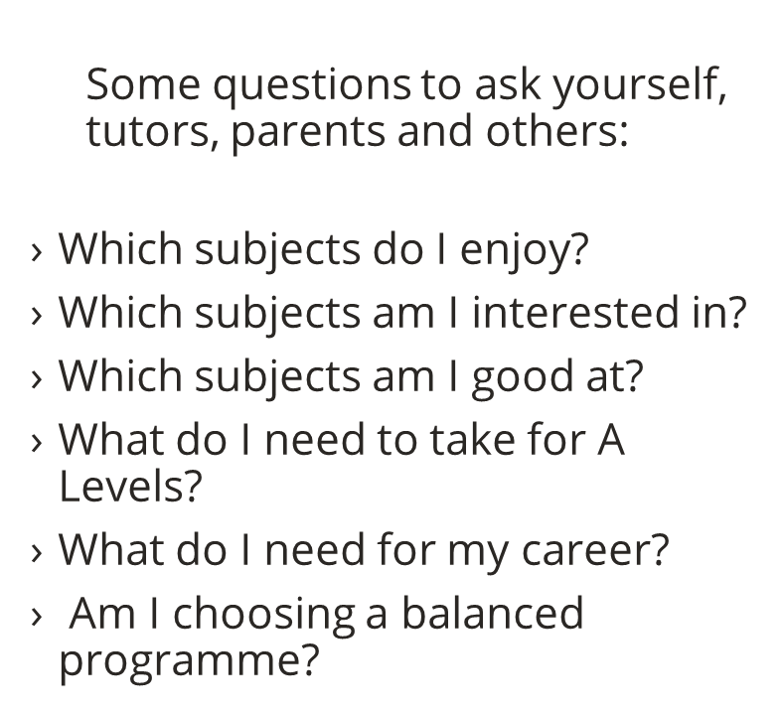
Conversations

Slide 19
Decisions – My Advice
Play to your strengths
Be realistic
Keep a balance
Be sure (but nothing must be final!)

