Slide 1
YEAR 1
Addition & Subtraction
Part-whole model
Addition symbol
Fact families – addition facts
Number bonds within 10
Systematic number bonds
Block 2 – Week 5

Slide 2
Lesson 1
Step: Part-whole model

Slide 3
Fluency
Complete the part-whole models.
5
7

Slide 4
Fluency
Complete the part-whole models.
6
4

Slide 5
Fluency
Complete the part-whole models.
8
10

Slide 6
Fluency
Complete the part-whole models.
1
4
4
6
3
2

Slide 7
Fluency
Complete the part-whole models.
3
6
8
9
5
3

Slide 8
Fluency
Complete the part-whole models.
7
4
10
5
3
1

Slide 9
Fluency
Complete the part-whole models.
7
9

Slide 10
Fluency
Complete the part-whole models.
8
5
4
2
2
1
2
2

Slide 11
Fluency
Match the part-whole model to the correct total.
9
?
8
10
7

Slide 12
Reasoning
Spot the mistake on the part-whole model.
9
Explain your answer.
The whole is 10 (not 9).
4 red counters + 6 yellow counters.

Slide 13
Problem solving
How many different ways can you sort the fruit?
6
Draw part-whole models to show this.
Red fruit and green fruit.
Apples and not apples.
Hard fruit and soft fruit
Large fruit and small fruit.
Sorted by colour

Slide 14
Lesson 2
Step: Addition symbol

Slide 15
Fluency
Complete:
2
2
______ red counters plus
______ yellow counters
is equal to ______ counters.
3
5
5
3
2
+
3
=
5

Slide 16
Fluency
Complete:
6
6
______ red counters plus
______ yellow counters
is equal to ______ counters.
2
8
8
2
6
+
2
=
8

Slide 17
Fluency
Complete:
5
5
______ red counters plus
______ yellow counters
is equal to ______ counters.
4
9
9
4
5
+
4
=
9

Slide 18
Fluency
Complete the part-whole model and number sentences.
1
1
+
4
=
5
5
4
+
1
=
5
4

Slide 19
Fluency
Complete the part-whole model and number sentences.
3
3
+
4
=
7
7
4
+
3
=
7
4

Slide 20
Fluency
Complete the part-whole model and number sentences.
2
2
+
7
=
9
9
7
+
2
=
9
7

Slide 21
Fluency
Complete the part-whole model and number sentences.
6
6
+
4
=
10
10
4
+
6
=
10
4

Slide 22
Fluency
Complete the number sentence.
3 + 1 =
4

Slide 23
Fluency
Complete the number sentence.
3 + 3 =
6

Slide 24
Fluency
Complete the number sentence.
2 + 5 =
7

Slide 25
Fluency
Complete the number sentence.
6 + 4 =
10

Slide 26
Fluency
Match the number sentences to the correct totals.
4 + 1 =
9
8 + 2 =
7
6 + 3 =
10
5 + 2 =
5

Slide 27
Reasoning
The counters represent the number sentence.
5
+
4
=
10
Explain your answer.
The counters and number sentence do not match.
There are 6 red counters (not 5).

Slide 28
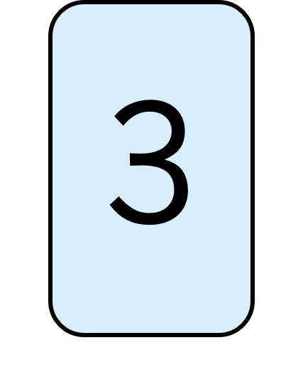
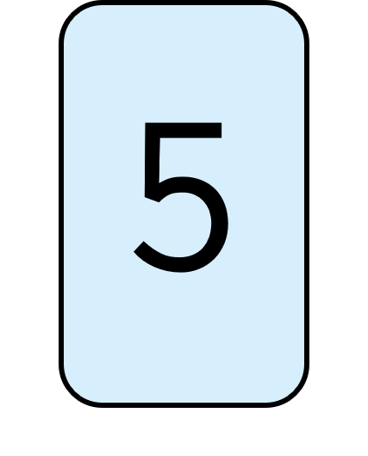
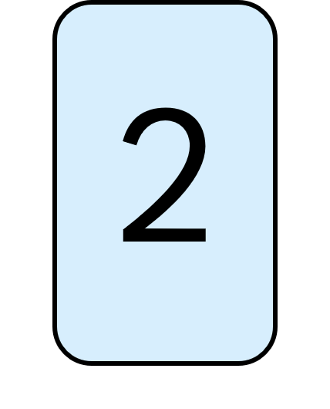
Problem solving
Use the digit cards once to create a number sentence.
2
+
3
=
5

Slide 29
Lesson 3
Step: Fact families - Addition facts

Slide 30
Fluency
Use the part-whole model to complete the missing numbers.
4
+
2
=
6
4
2
+
4
=
6
6
6
=
4
+
2
2
6
=
2
+
4

Slide 31
Fluency
Use the part-whole model to complete the missing numbers.
4
+
5
=
9
4
5
+
4
=
9
9
9
=
4
+
5
5
9
=
5
+
4

Slide 32
Fluency
Complete the number sentences.
3
+
1
=
4
4
=
3
+
1
1
+
3
=
4
4
=
1
+
3

Slide 33
Fluency
Complete the number sentences.
4
+
2
=
6
6
=
4
+
2
2
+
4
=
6
6
=
2
+
4

Slide 34
Fluency
Complete the number sentences.
5
+
3
=
8
8
=
5
+
3
3
+
5
=
8
8
=
3
+
5

Slide 35
Fluency
Complete the number sentences.
6
+
4
=
10
10
=
6
+
4
4
+
6
=
10
10
=
4
+
6

Slide 36
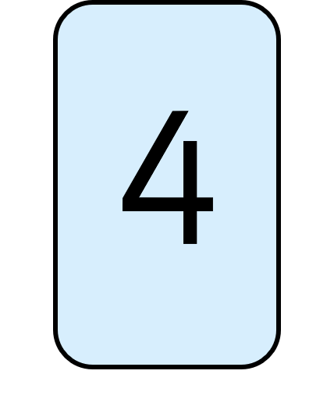
Reasoning
The total is more than 6 and even.
Only one of the digit cards can be used in the number sentence.
True or false?
4
+
?
True.
Only the 4 can be used (4 + 4 = 8). 8 is even and more than 6.

Slide 37
Problem solving
The value of the square is less than 3, but more than 0.
+
=
6
What could the value of the square and circle be?
+
=
6
=
1 or 2
6
=
+
=
5 or 4
6
=
+

Slide 38
Lesson 4
Step: Number bonds within 10

Slide 39
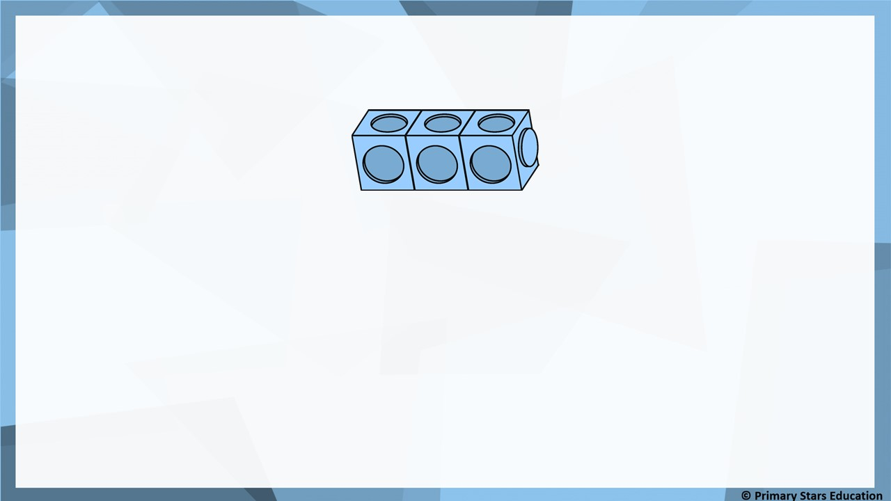
Fluency
Complete number sentences for bonds to 3:
0
+
3
=
3
2
+
1
=
3
1
+
2
=
3
3
+
0
=
3

Slide 40
Fluency
Complete number sentences for bonds to 5:
0
+
5
=
5
3
+
2
=
5
1
+
4
=
5
4
+
1
=
5
2
+
3
=
5
5
+
0
=
5

Slide 41
Fluency
Complete number sentences for bonds to 6:
0
+
6
=
6
1
+
5
=
6
4
+
2
=
6
2
+
4
=
6
5
+
1
=
6
3
+
3
=
6
6
+
0
=
6

Slide 42
Reasoning
The circled number bond is the odd one out.
4 + 1
5 + 0
2 + 4
3 + 2
True or false?
Explain your answer.
False, the odd one out is 2 + 4 as this is a number bond to 6 whereas all the others are number bonds to 5.

Slide 43
Problem solving
How many different ways can the remaining dots be put on the toadstools?
9 different ways:
8 + 0 = 8
7 + 1 = 8
6 + 2 = 8
5 + 3 = 8
4 + 4 = 8
3 + 5 = 8
2 + 6 = 8
1 + 7 = 8
0 + 8 = 8
For example: 5 + 3 = 8

Slide 44
Lesson 5
Step: Systematic number bonds

Slide 45
Fluency
Complete:
5 = 5 + 0
5 = 4 + 1
5
3
2
___ = ___ + ___
5
2
3
___ = ___ + ___
5
1
4
___ = ___ + ___
5
0
5
___ = ___ + ___

Slide 46
Fluency
Complete:
6 = 6 + 0
6 = 5 + 1
6 = 4 + 3
6
3
3
___ = ___ + ___
6
2
4
___ = ___ + ___
6
1
5
___ = ___ + ___
6
0
6
___ = ___ + ___

Slide 47
Fluency
Complete:
4 + 0 = 4
3 + 1 = 4
2 + 2 = 4
1
3
4
___ + ___ = ___
0
4
4
___ + ___ = ___

Slide 48
Reasoning
Spot the mistake in the bond pattern.
0 + 5 1 + 4 3 + 2 2 + 3 4 + 1 5 + 0
Explain the mistake.
3 + 2 and 2 + 3 are the wrong way round.
It should be:
2 + 3 3 + 2

Slide 49
Problem solving
How many different ways can the remaining spots be put on the ladybird?
8 different ways:
7 + 0 = 7
6 + 1 = 7
5 + 2 = 7
4 + 3 = 7
3 + 4 = 7
2 + 5 = 7
1 + 6 = 7
0 + 7 = 7
For example, 4 + 3 = 7

