Slide 1
RSE Consultation

Slide 2
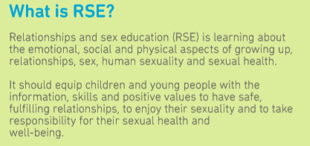
What is RSE?
Helping young people to form relationships and develop in ways which are:
Age appropriate
Safe
Supported
Fulfilling
Healthy

Slide 3
PSHE and RSE at Bootham
Why?
  Part of the school commitment to "liberate and equip its young people to flourish as adults and to live adventurous lives that will serve to create a better world."
When?
  PSHE lessons in Schoolrooms (1 lesson a week) and Seniors (1 lesson a fortnight)
  College talks as part of Specials series.
With whom?
  Beth (Head of Wellbeing, Head of Usch, experience as a Deputy DSL in two schools)
  Other members of the team include members of the health centre team, deputy DSL and members of the pastoral team.
  Relevant training undertaken and best practice shared within department meetings.

Slide 4


Lessons and Resources
Resources
Lessons
High quality
  Quality assured by PSHE Association, Sex Education Forum or other relvant body such as the NHS
  Bespoke resources produced for Bootham
Accurate
Age Appropriate
Signposting support and further information
Baseline assessment
  Input into upcoming content
  Confidence checker
  Mindmap of existing knowledge
  EITAA
  Discussion statement
Knowledge Boost
  Information sheets
  Videos/documentaries
  Case studies
  Peer knowledge
Reflection, discussion
Recording
  Memory lane
  Revisit baseline assessment
Questions

Slide 5
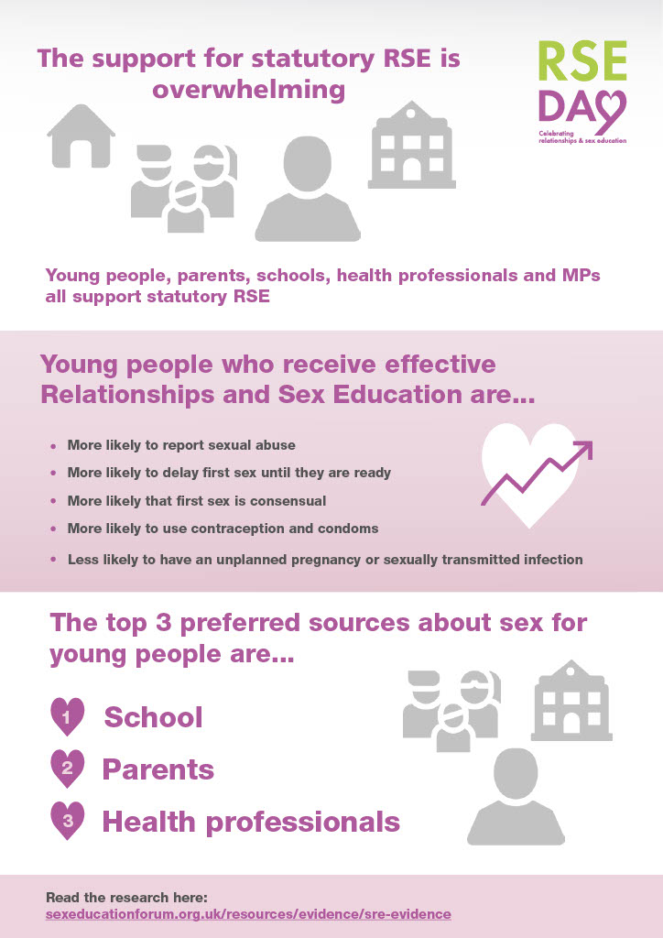
Benefits of RSE

Slide 6
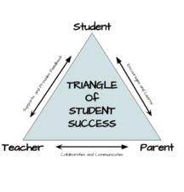
Working Together
Good RSE is a partnership between parents/carers, the school and students.
Schools and parents/carers are repeatedly listed as the top two sources of information for young people when it comes to sex and relationships

Slide 7
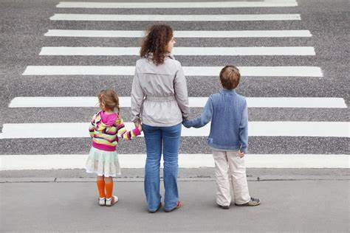
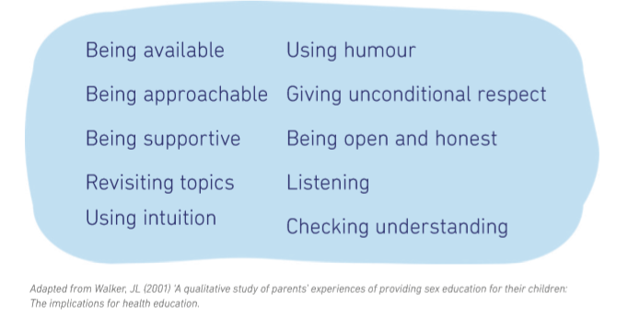
RSE At Home
“When they’re old enough to know, they’ll ask”
“They’ll work it out”

Slide 8
Withdrawal
Up until 3 terms before a student turns 16 their parent/carer can withdraw them from sex education
This does not include
  Reproduction as covered in Biology lessons
  Relationships education
  Elements covered in Health Education (eg puberty, personal health checks)
From 3 terms before a student turns 16, the student can opt to return to sex education lessons and alternative provision can be made to cover content missed
To withdraw a student from sex education lessons a request should be made through the Headmaster. Alternative provision will be made for students during those lessons and resources will be made available at home.

Slide 9
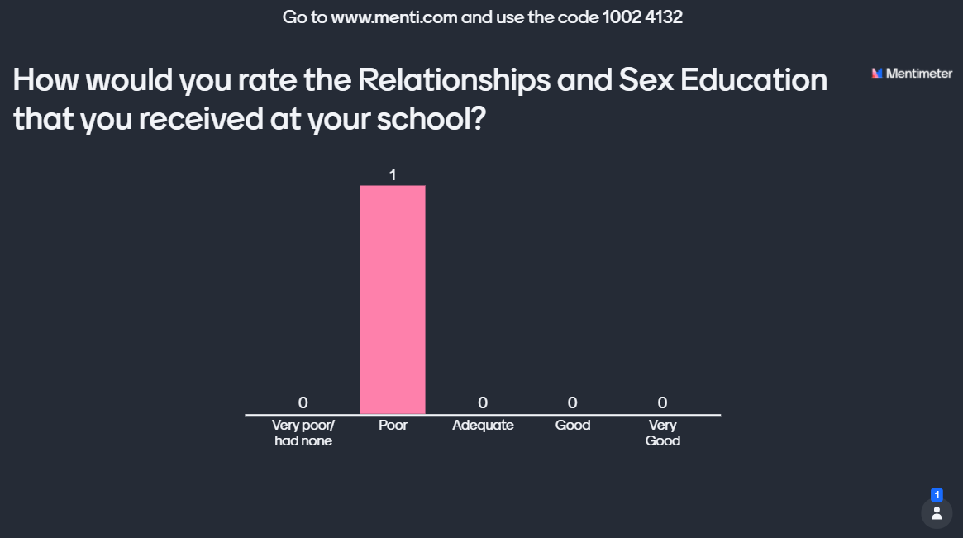
Reflecting on our RSE
Menti
For discussion
  Was it enough?
  What was good?
  What was bad?
  What might be different for young people now?
  What would great PSHE look like for our young people?

Slide 10
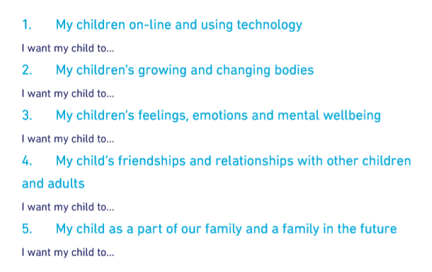
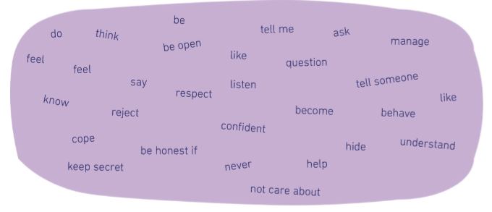
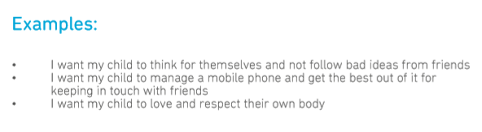
Padlet: What do you think our young people should know?
At 11?
At 13?
At 16?
At 18?
Knowledge, skills, values, attitudes
https://padlet.com/boothambeth/RSE2021

Slide 11
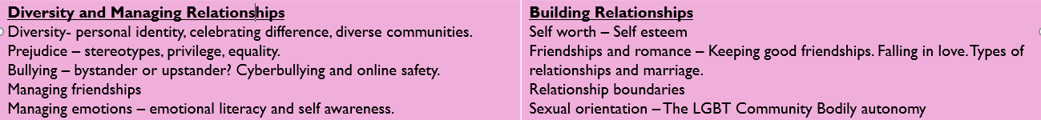
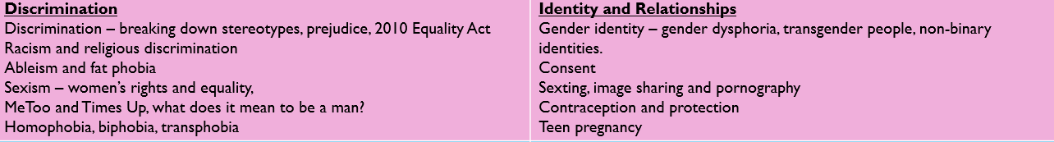
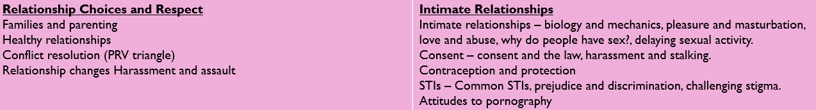
Bootham Curriculum: Schoolrooms

Slide 12
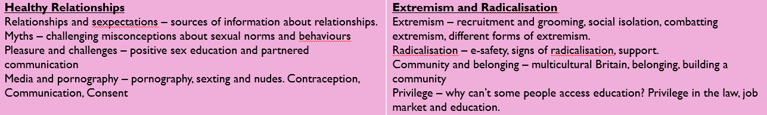
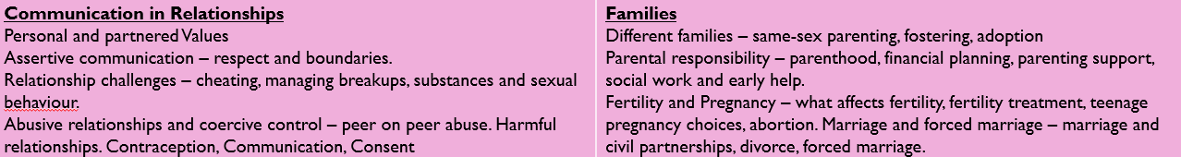
Bootham Curriculum: Seniors

Slide 13
PSHE Portal
Launching by Christmas
Areas for students (by age) and parents
Information and sources of support
Covering
Health and Wellbeing
Relationships and Sex Education
Careers and the Wider World
Parental feedback questionnaire
Ask It Basket

